Slide 1
SEL Family Activity (K-2)
Week of June 8, 2020
Getting Along with Others
©TheSocialEmotionalTeacher

Slide 2
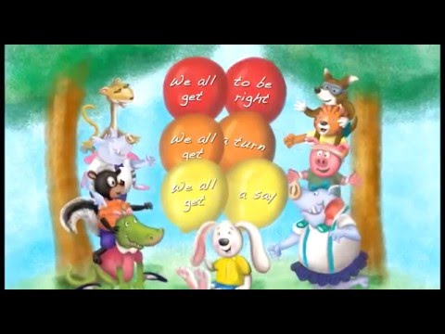
Think:
Did Howard know how to get along with his friends?
What did he learn from his grandma?
What are the 4 rules to get along with others?
Do:
Help Howard figure out how to help others get along at the end of the video.

Slide 3
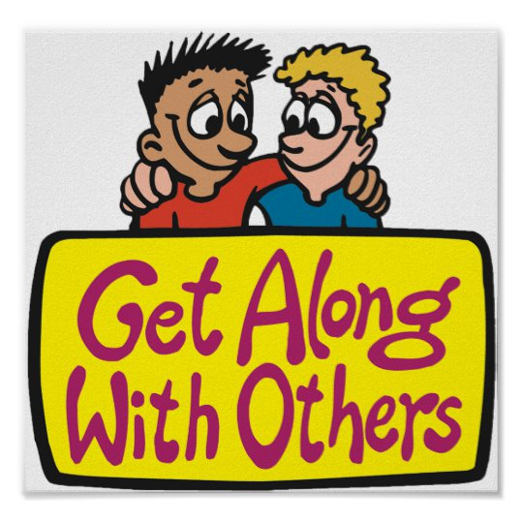
Activity:
Write/Draw about a time you used one of the 4 rules for getting along:
Review the Rules:
1.Everyone needs to have a say
2.Everyone needs to have a turn
3.Everyone gets to be right
4.Apologize

Slide 4
SEL Family Activity (3-5)
Week of June 8, 2020
Growth Mindset
©TheSocialEmotionalTeacher

Slide 5
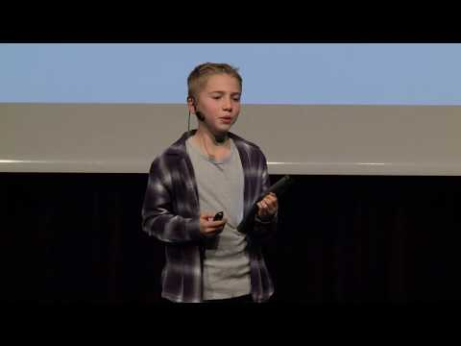
Think:
What is a growth mindset?
How did Michael Jordan have a growth mindset?
Why would coaches want someone with a growth mindset?
What is the difference between a growth mindset and a fixed mindset?
How did Carson, the 5th grader speaking in the video, use a growth mindset in reading?
How can you have the mindset of a champion?

Slide 6
Activity:
Write about something you can’t do YET, and come up with some steps to get closer to achieving it.

