Slide 1
SEL Family Activity (K-2)
Week of May 11 2020
Finger Breathing
©TheSocialEmotionalTeacher

Slide 2
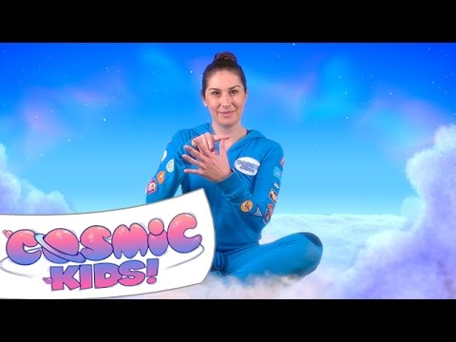
Think:
What are some things that make you feel nervous or worried?
What clever ways did you learn to balance the nervous feelings with calm feelings?
Do:
Practice the finger breathing strategy along with the video.

Slide 3
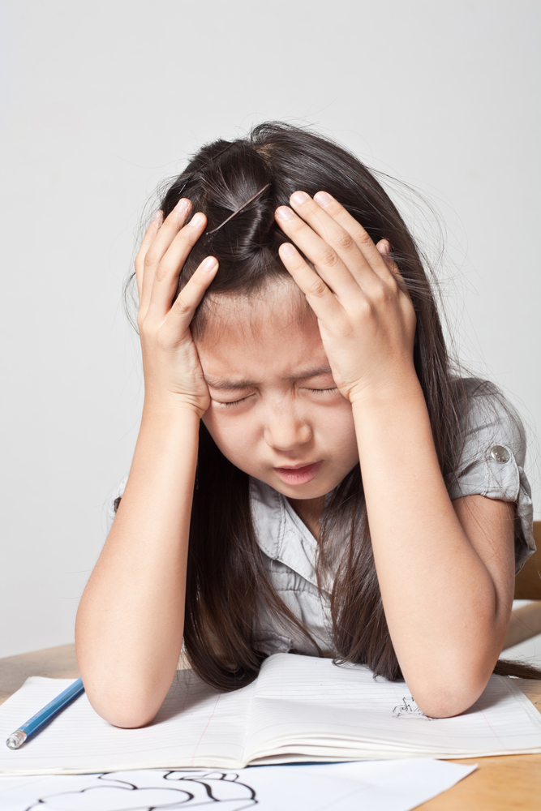
Activity:
Set a timer for 4 minutes. Think of ALL the things you feel worried about. Now practice the finger breathing exercise you learned in the video. How do you feel?

Slide 4
SEL Family Activity (3-5)
Week of May 11, 2020
Mindfulness Breathing
©TheSocialEmotionalTeacher

Slide 5
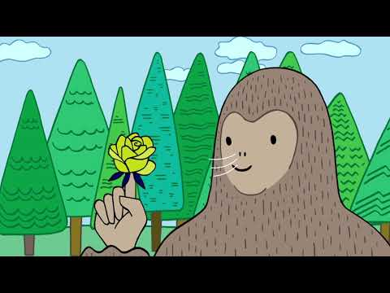
Mindful breathing is a strategy to help us manage our emotions. If we feel worried, sad, angry, overwhelmed, frustrated, etc. we can practice mindful breathing to calm down. Try it now by pressing play!
Think:
How do you feel after completing the mindful breathing?
How can this strategy help you in the future?

Slide 6
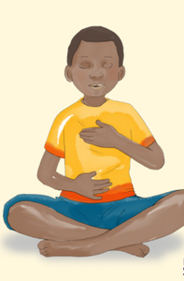
Activity:
Set a timer for 4 minutes. Think of ALL the things you feel worried about. Now practice one of the breathing exercises you learned in the video. How do you feel?

