Slide 1
SEL Family Activity (K-2)
Week of June 15, 2020
The Power of Kindness
©TheSocialEmotionalTeacher

Slide 2
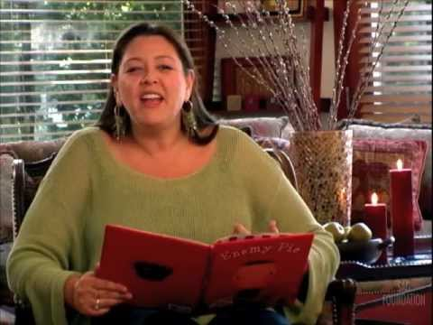
Think:
Why does the main character dislike Jeremy Ross?
How did the main character change as he spent his day with his neighbor, Jeremy?
What message or lesson can we learn from this book?
Did you ever have a similar problem as the main character?

Slide 3
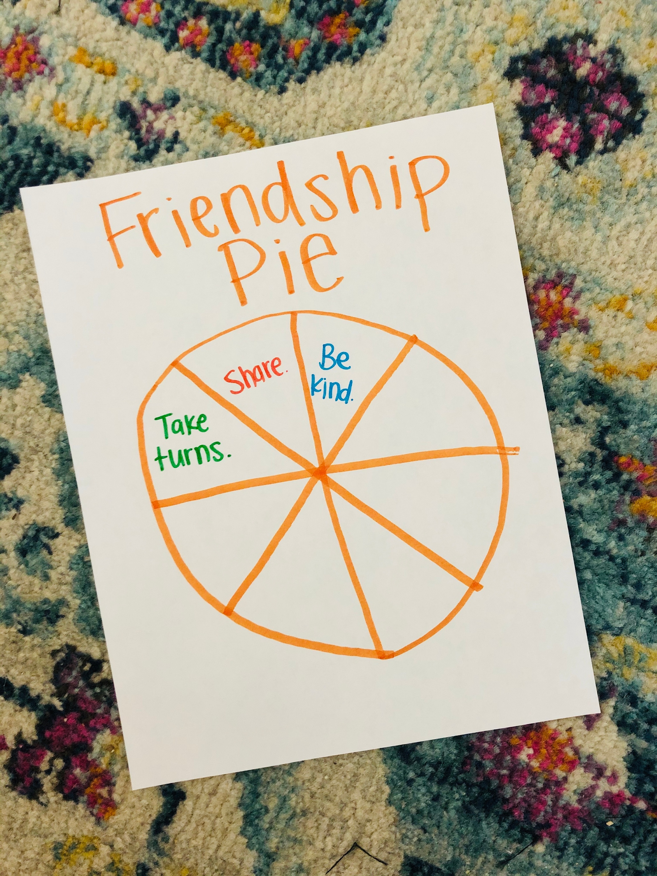
Activity:
Make a friendship pie. Draw a big circle on a piece of paper and divide it into sections. Write 1 way you can be a good friend in each section.

Slide 4
SEL Family Activity (3-5)
Week of June 15, 2020
The Power of Kindness
©TheSocialEmotionalTeacher

Slide 5
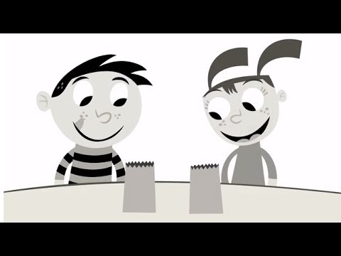
Think:
What do you see happening in the video?
What is happening to add color?
How can you color the world around you?

Slide 6
Activity:
Write a persuasive letter, convincing someone to help “color the world” by spreading kindness. Give at least 3 reasons why they should help.

