Slide 1
SEL Family Activity (K-2)
Week of May 18 2020
Managing Powerful Feelings
©TheSocialEmotionalTeacher

Slide 2
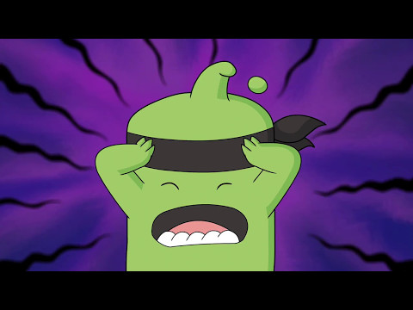
Think:
What is “the beast” in the video?
What made Mojo’s beast appear?
Think about a time you have experienced “the beast.”

Slide 3
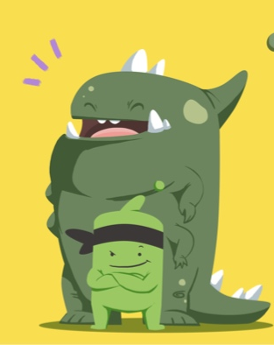
Activity:
Think about a time when your “beast” appeared. Draw a picture of your beast.

Slide 4
SEL Family Activity (3-5)
Week of May 18, 2020
Managing Powerful Feelings
©TheSocialEmotionalTeacher

Slide 5
Think:
What is “the beast” in the video?
What made Mojo’s beast appear?
Think about a time you have experienced “the beast.”
Do:
Re-watch the mindful breathing video from last week on the next slide, and follow along. Notice how you feel after.

Slide 6
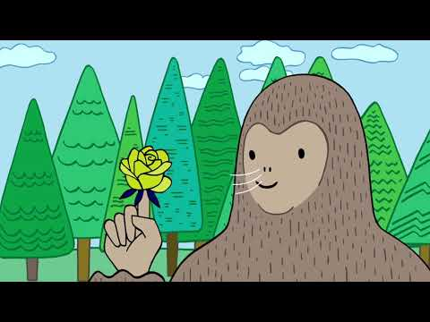

Slide 7
Activity:
Think about a time when your “beast” appeared. Write a letter to your beast about how he/she makes you feel and how you can conquer him/her.

