Slide 1
SEL Family Activity (K-2)
Week of April 20, 2020
Emotions

Slide 2
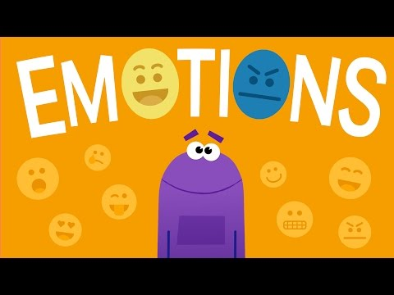
Think:
Which emotion are you feeling right now?
What can you do when you are feeling grumpy?
What can you do when you are feeling sad?
Do:
Make a list of all of the things that make you happy.

Slide 3
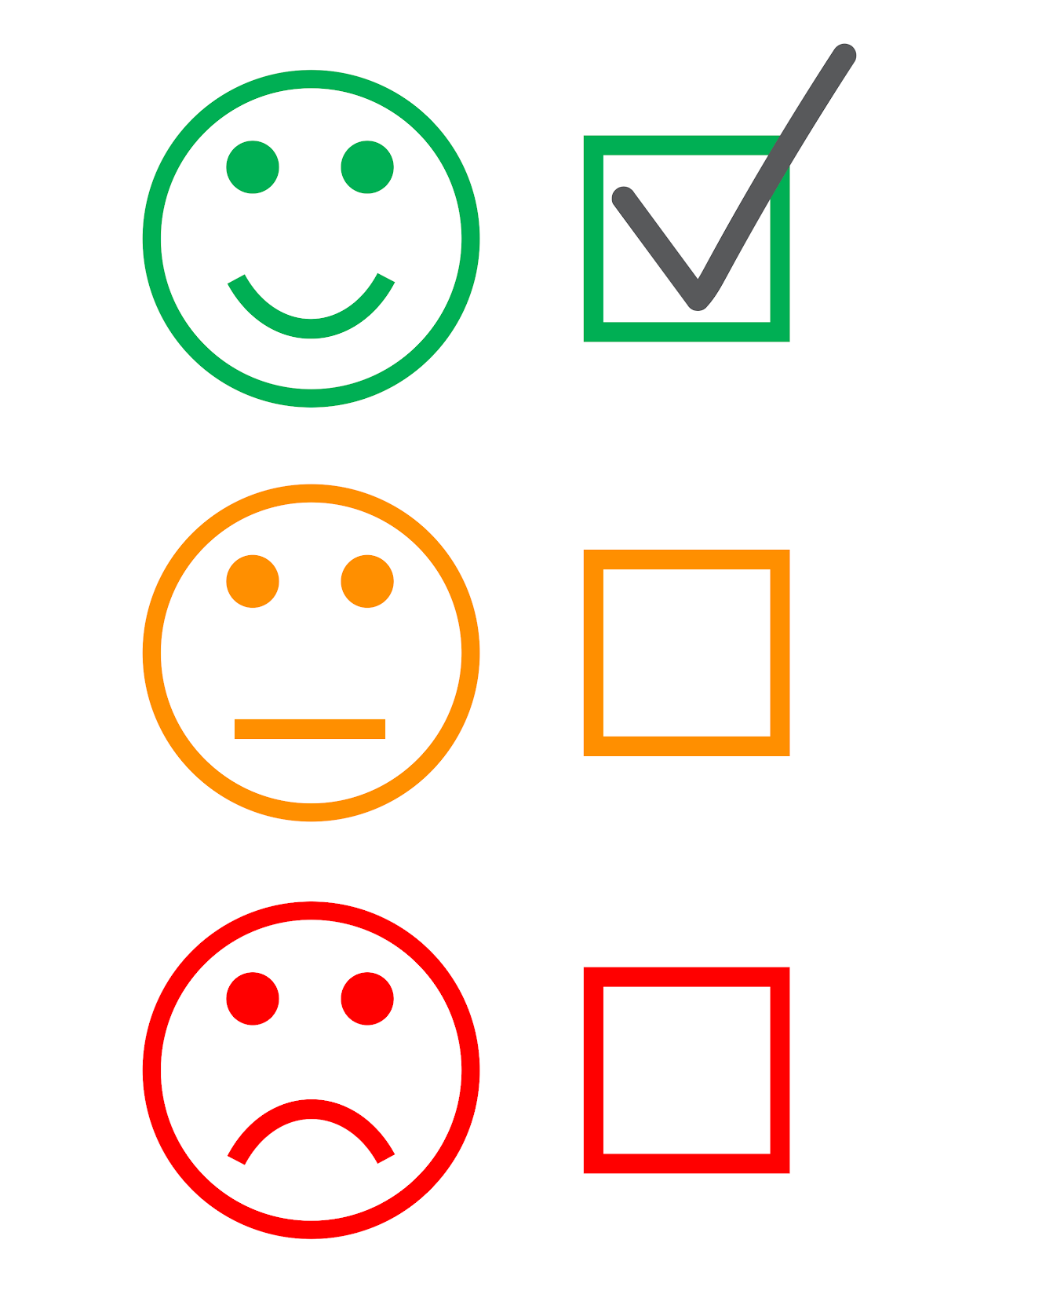
Family Activity:
Make a list of all the things that make you happy.

Slide 4
SEL Family Activity (3-5)
Week of April 20, 2020
Emotions
©TheSocialEmotionalTeacher

Slide 5
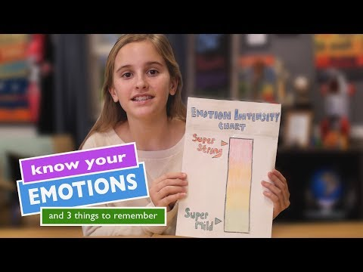
Think:
What emotion or emotions are you feeling right now?
How can you measure your emotions?
Do emotions change or stay the same?
“There are no good or bad emotions.” Do you agree or disagree? Why?

Slide 6
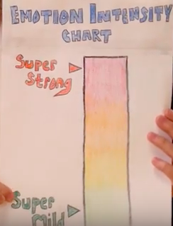
Family Activity:
Draw your own emotion intensity chart and measure your emotions throughout the day.

