Slide 1
SEL Family Activity (K-5)
Week of May 25, 2020
Making Mistakes
©TheSocialEmotionalTeacher

Slide 2
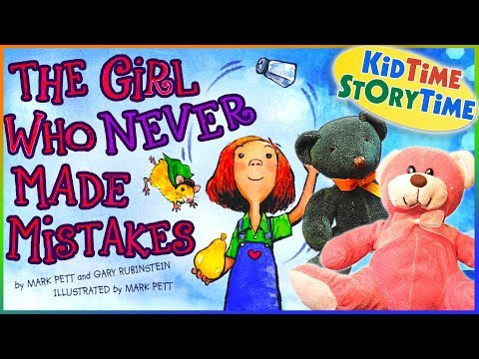
Think:
How do you feel about making mistakes?
Were you ever afraid of something but you did it anyway? What made you try something scary?
Beatrice “felt her stomach jumping around inside her.” How do you think she is feeling? How do you know?
In your opinion, which is more important: learning from your mistakes or being perfect?

Slide 3
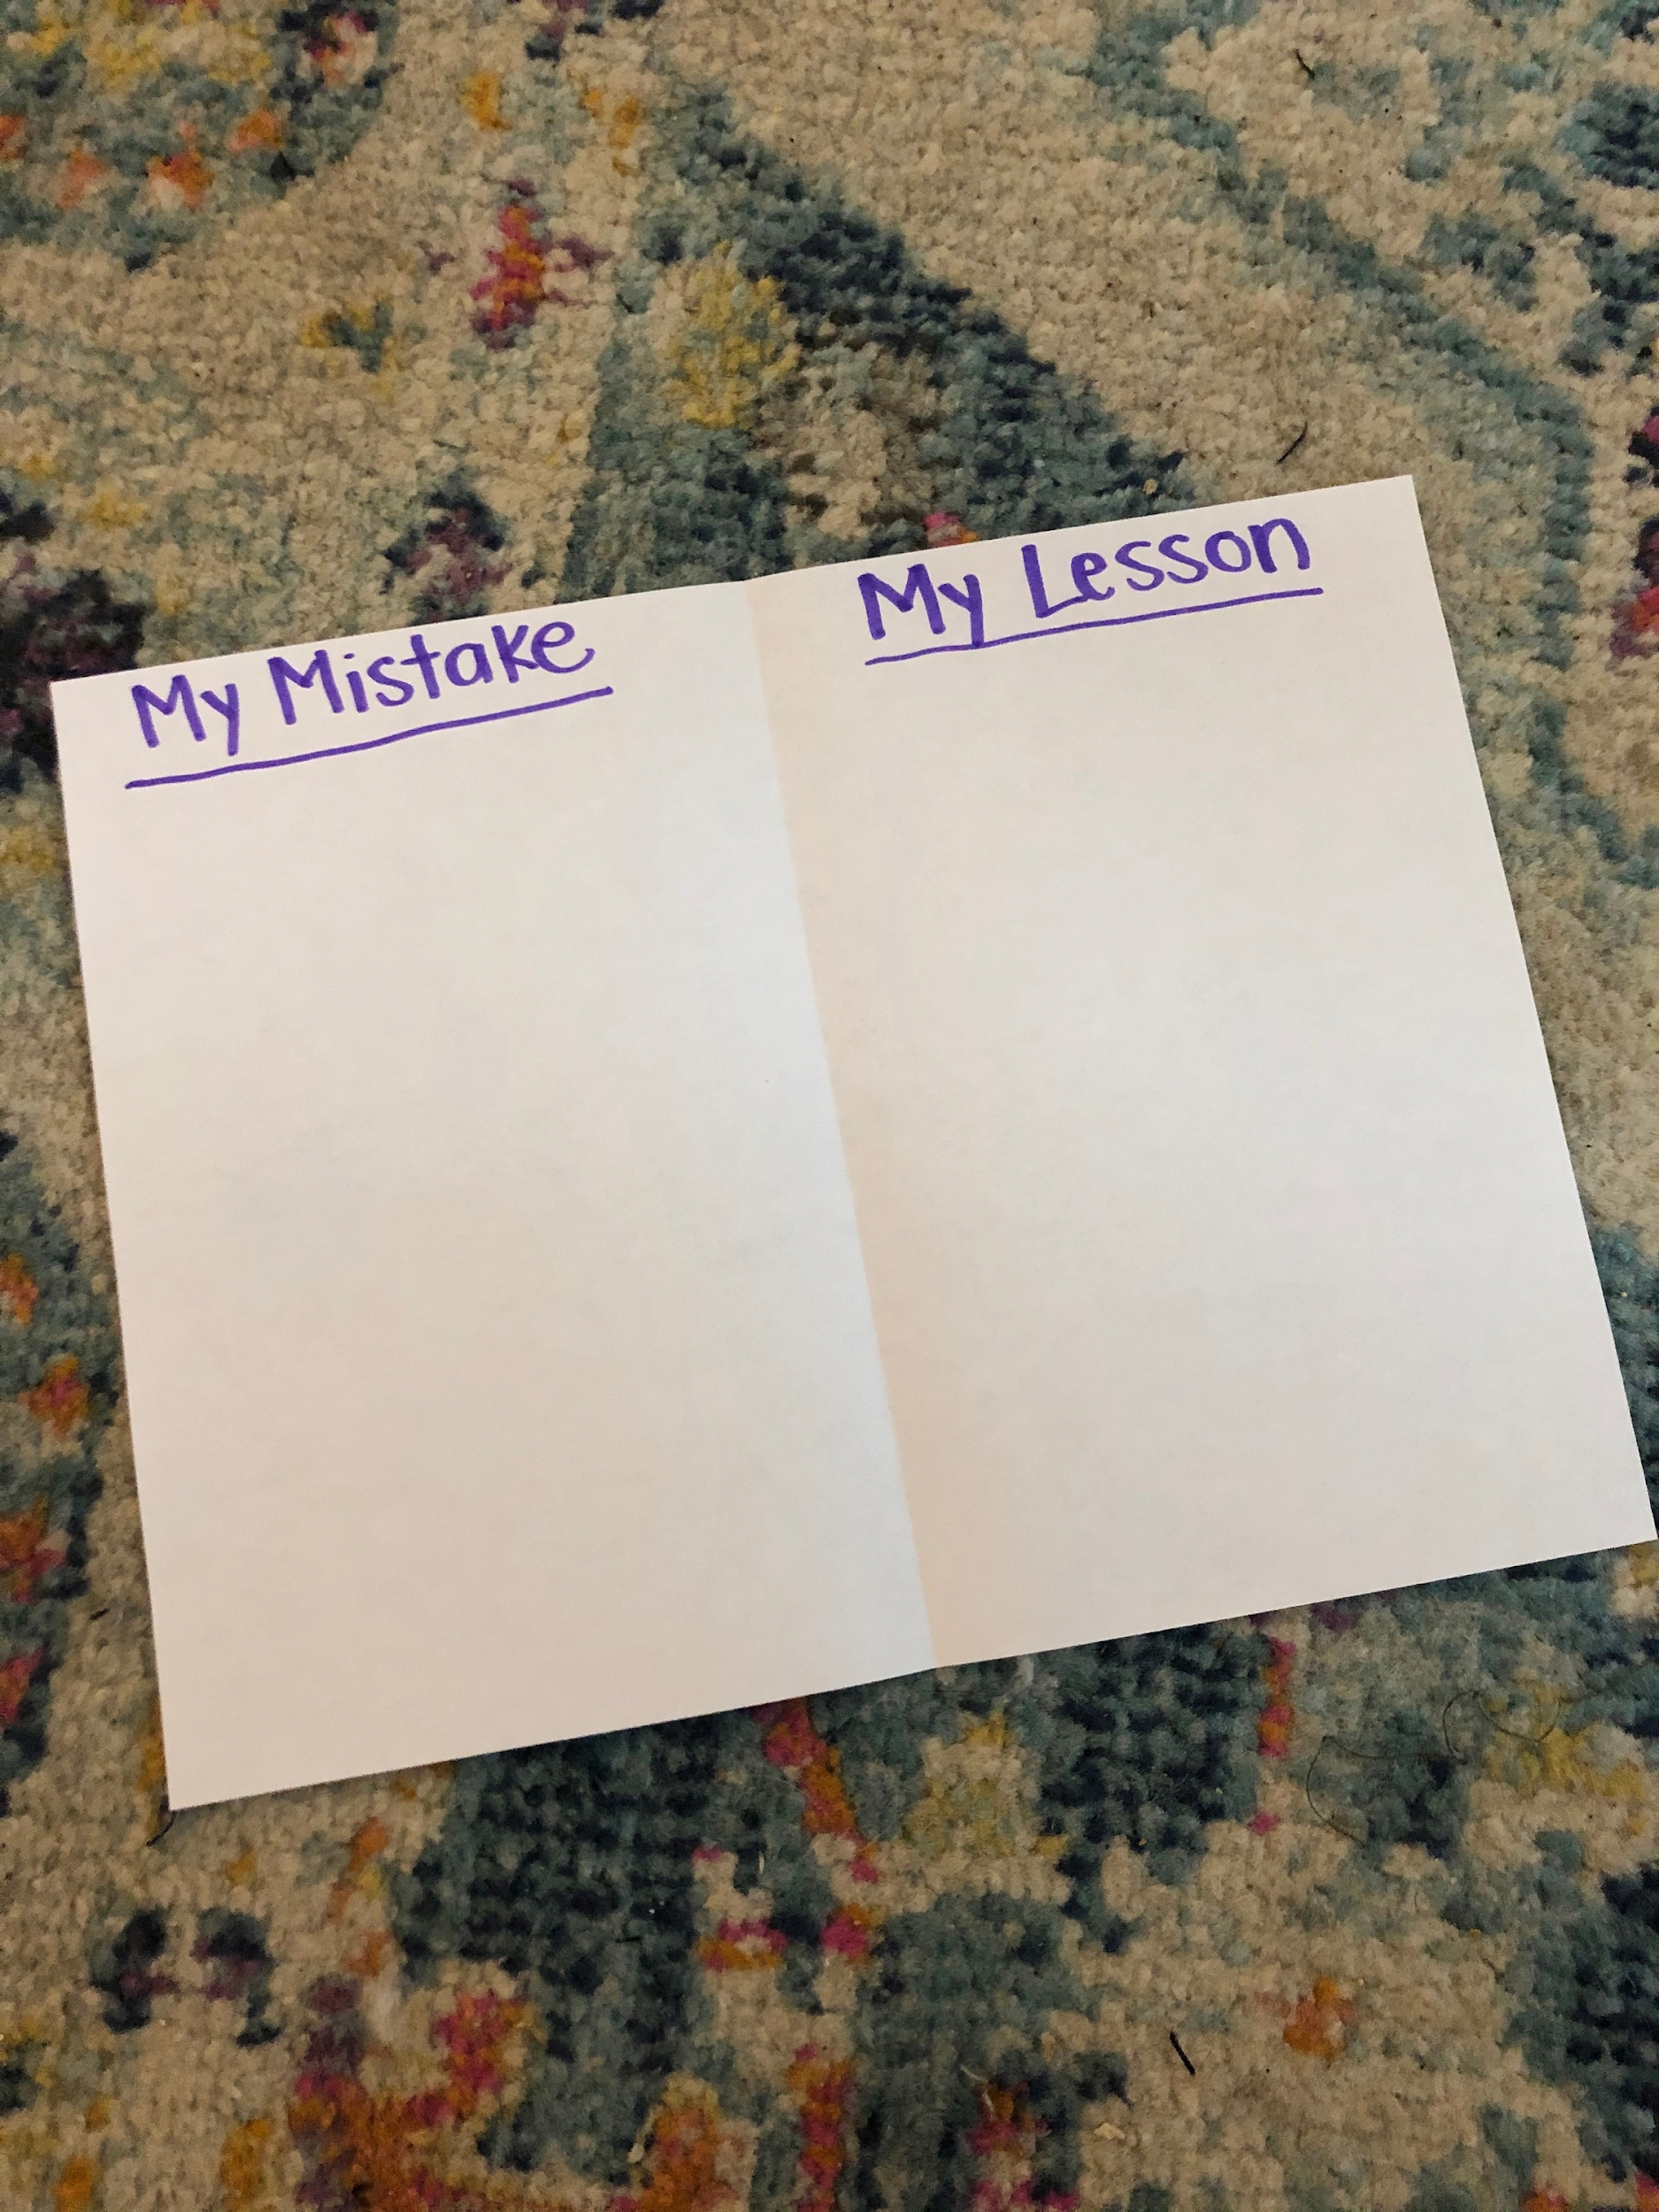
Activity:
Fold a piece of paper in half. On one side, draw or write about a mistake you have made. On the other side, draw or write the lesson you learned from your mistake.

