Slide 1
SEL Family Activity (K-5)
Week of June 1, 2020
Self-Compassion

Slide 2
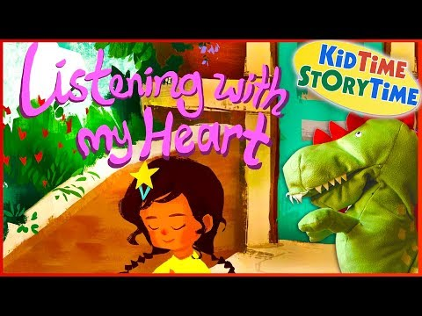
Think:
What is self-compassion?
Think about a time you have gotten mad at yourself.
Do you think it is easier to be kind to yourself or others? Why?
If you could talk to Esperanza after she runs off the stage, what would you say to her?
How can you spread love and kindness into the world?

Slide 3

Activity:
Write some kind words to yourself. This can be a letter, drawings of kind words, or positive statements. Say them out loud to yourself.

