Slide 1
SEL Family Activity (K-2)
Week of May 4, 2020
Managing Anger
©TheSocialEmotionalTeacher

Slide 2
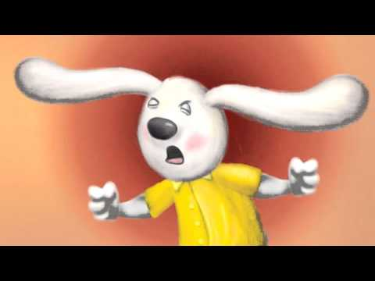
Think:
Have you ever felt like Howard?
How did Howard learn to listen to his body when it was angry?
What were some of the things Howard learned to do when his body felt angry?
What lesson can you learn from Howard?

Slide 3
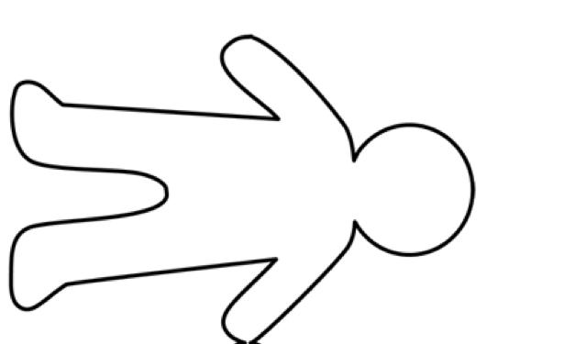
Activity:
Draw an outline of your body when it feels angry. Mark the parts where you feel the anger in red.

Slide 4
SEL Family Activity (3-5)
Week of May 4, 2020
Managing Worry
©TheSocialEmotionalTeacher

Slide 5
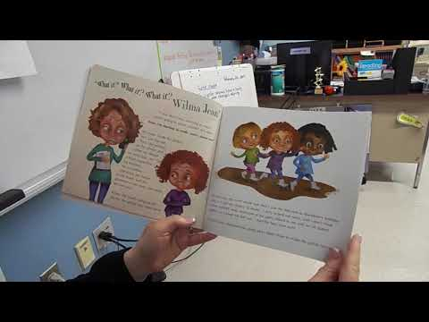
Think:
What are some of the worries Wilma Jean has? Can you relate to her worries?
What happens to Wilma Jean when she worries?
What did Wilma Jean’s teacher do to help Wilma Jean with her worrying?
Why is sorting our worries (like Wilma Jean’s teacher did) helpful?
Do:
Make a list of your worries.

Slide 6
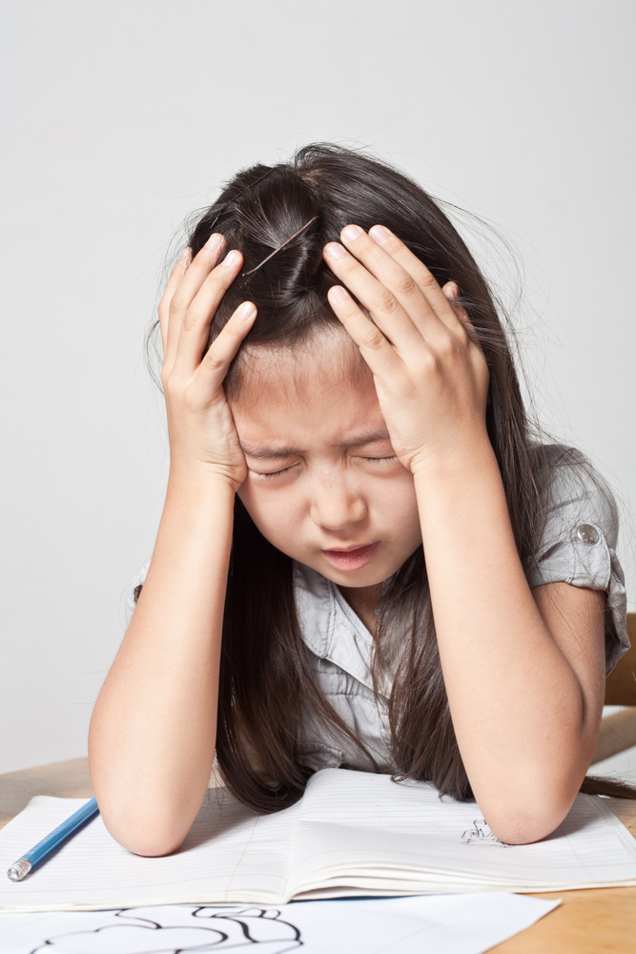
Activity:
Write about something you worry about. Why do you worry about it? How does it affect your life? Can you control it? What are some steps to take to help with this worry?

